Slide 1
USER INTERFACES FOR
EMBEDDED SYSTEMS
Presentation:
Cognitive Psychology,
Principles, and Methods

Slide 2
Outline
The Psychology of HCI
Human Cognition
  Human senses, perception, memory, and interruptions
  Mental models, metaphors, and perceived affordance
  Which will connect the Psychology theory with heuristics (best practices)
Methods we may employ
Performing a CW

Slide 3
The Psychology of HCI
Two main theoretic frameworks
  Cognitive Sciences
  Social Computing
Both with user involvement!
  But with different backgrounds
  We will not spend too much time on discussing this
  Note: the Cognitive School is more “hard science” and “lab oriented” than is Social Computing

Slide 4
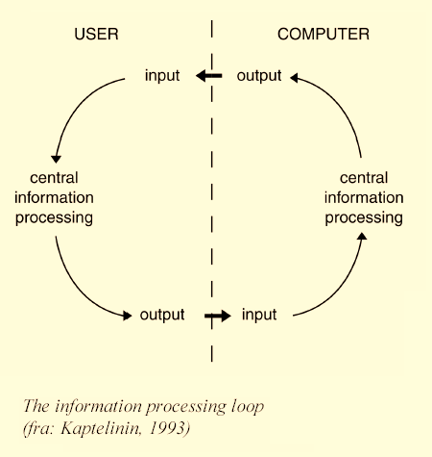
Cognitive HCI
Cognitive psychology: the study of how people perceive, learn, and remember (USA 1950’s)
Cognition: the act or process of knowing (DK: erkendelse/viden)
“The Psychology of HCI” until late 1980’s
  Cognitive HCI
  human mind as a series of information processors
  input, output, information processor
  The body is only hardware

Slide 5
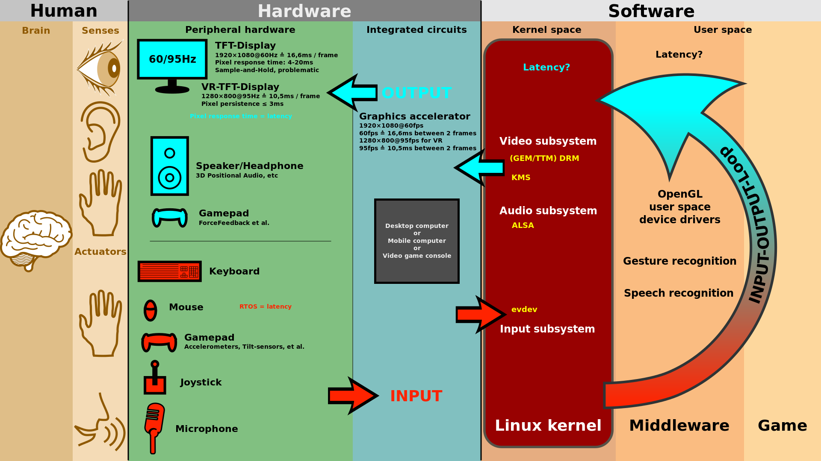

Slide 6
Why do we care?
Because when people try to understand something, they use a combination of
  What their senses are telling them
  The past experience they bring to the situation
  Their expectations
And this involves:
  Human senses, perception, memory, and interruptions
  Mental models, metaphors, and perceived affordance
Understanding Cognition is key to Usability

Slide 7
Senses
Senses (sight, hearing, smell, taste, touch) provide data about what is happening around us
We are visual beings (“See what I mean?”)
Visual Sense perceived as ”most important”
Designing good User Interfaces requires knowledge about how people perceive
What senses do you use with your cell phone?
Notes:
Have a little list of other visual metaphors, or invite suggestions from class. “I can’t see Dan playing Falstaff” is a possibility.

Slide 8
Constructivism
Our brains do not create pixel-by-pixel images
Our minds create, or construct, models that summarize what comes from our senses
These models are what we perceive
When we see something, we don’t remember all the details, only those that have meaning for us
  How many links are there on top menu of amazon.com?
  What are the colors on your favorite cereal box?
  How many lines are there in the IBM logo?
  Who cares?
  Moral: People filter out irrelevant factors and save only the important ones
Notes:
Sigh. Artists develop “visual memory” and can paint quite accurately from memory. And a few people have what is properly called “eidetic memory,” popularly called photographic memory. But these are exceptions; very few people have eidetic memory, and artists study long and hard to develop visual memory. When we say “Our brains do not create pixel-by-pixel images,” we mean it in the context of the kinds of things users need to remember.
If a student has taken a cognitive psych course and challenges the first bullet, give him the floor. She’s right, but not in this context.

Slide 9
Context
Context plays a major role in what people see in an image
Mind set: factors that we know and bring to a situation
Mind set can have a profound effect on the usability of a web site

Slide 10
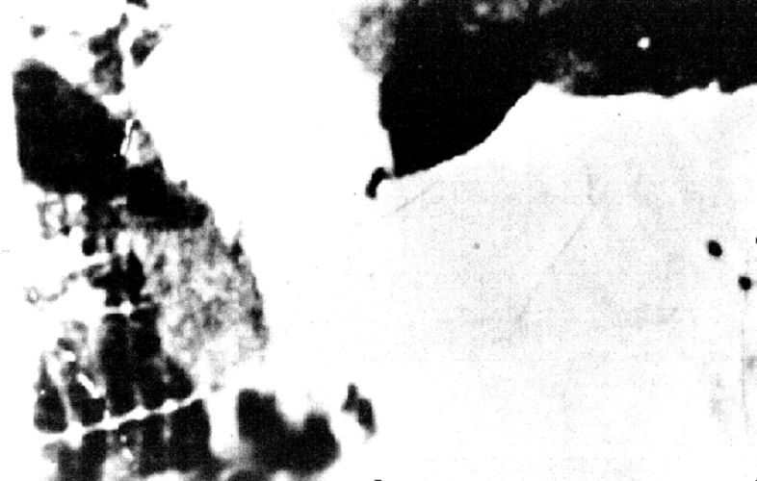
Example of context: What do you see?

Slide 11
Hint: it’s an animal, facing you . . .

Slide 12
Hint: this animal gives milk, and her face takes up the left half of the picture . . .
Notes:
Neat trick: Press Ctrl-P and you’ll have a pen tool. You can circle the eyes and the one ear that’s identifiable, show the face, etc. Hold down the Shift key while drawing, and you’ll get a straight horizontal or vertical line. Warning: all your drawing disappears when you move to the next slide.

Slide 13
Why couldn’t you see the cow’s face at first?
It’s blurry and too contrasty, of course, but more:
You had no idea what to expect, because there was no context
Now that you do have a context, you will have little difficulty recognizing it the next time
  Try it again tomorrow
Notes:
Some people probably still won’t see it. Might back up and let them look a little more. The “Aha!” expressions are fun to watch. To drive home that expectations matter, this might be a good place for a classic story: An e-commerce site was having a huge number of abandoned shopping carts. Nobody could see why: the “Click Here to Place Your Order” button was very much in plain sight. In desperation (☺) the developers finally did some user testing. Explanation: the button was flashing, and most users expect that anything flashing is an advertisement. In a very practical sense, they couldn’t “see” the button.

Slide 14

Another example : are these letters the same?

Slide 15

Well, yes, but now in context:

Slide 16
Gestalt psychology
“Gestalt” is German for “shape,” but as the term is used in psychology it implies the idea of perception in context
We don’t see things in isolation, but as parts of a whole
Notes:
Somewhere in this section, emphasize the connection with website design, and note that these principles are applied directly—sometimes with different names—in Chapter 5, Visual Organization. Most HCI books have a section on Gestalt psychology; not all make the connection with graphic design.

Slide 17
Figure and ground
Images are partitioned into
  Figure (foreground) and
  Ground ( background)
Sometimes figure and ground are ambiguous

Slide 18

Figure and ground:
What do you see?
Rubin’s Figure: Example of Gestalt Theory’s Principle of Multistability (or Multistable Perception)
Notes:
A much-used example, but some students will not have seen it. It’s either a vase/birdbath/whatever, or it’s two profiles of people facing each other. Which is a pottery student more likely to see? A photography student? Mind set at work again.

Slide 19
Five principles of
Gestalt psychology
We organize things into meaningful units using
  Proximity: we group by distance or location
  Similarity: we group by type
  Symmetry: we group by meaning
  Continuity: we group by flow of lines (alignment)
  Closure: we perceive shapes that are not (completely) there
Notes:
“Gestalt” is capitalized because it’s a German noun, and nouns are capitalized in German. “Gestalt” is not the name of an early psychologist.

Slide 20
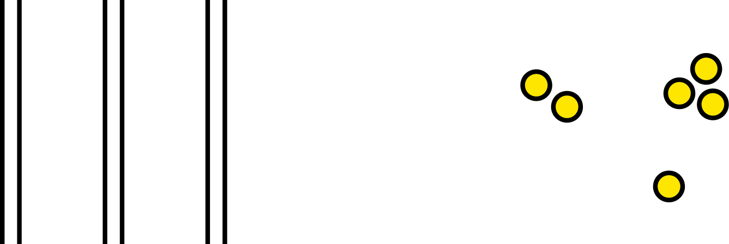
Proximity
Which shapes belongs together? Why?
Notes:
We see three groups of two lines each. We see three groups of ellipses, even though one “group” has only one member. (Maybe this is obvious, but there is no connection between the two examples.)

Slide 21
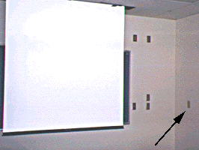
Proximity Example
Guess which switch controls the projector screen?
From www.baddesigns.com

Slide 22

Symmetry
We use our experience and expectations
to make groups of things – conventions of the mind
We see two triangles.
We see three groups of paired square brackets.
Notes:
At least that’s how they appear to the authors, both of whom have a programming background. Square brackets in a program almost always occur in pairs, so that’s how we see them here. Depending on the prerequisites for your course, you may have students who have zero programming experience. They may see this example differently.
In the triangles, some students may object: “We don’t just ‘see’ two triangles; those are triangles.” Use Ctrl-A Ctrl-P to get a pencil tool, and draw to show how the figure can be seen as three non-overlapping areas, only the center one of which is a triangle. (You can change the pencil tool color: right-click while in this mode to see options.)

Slide 23
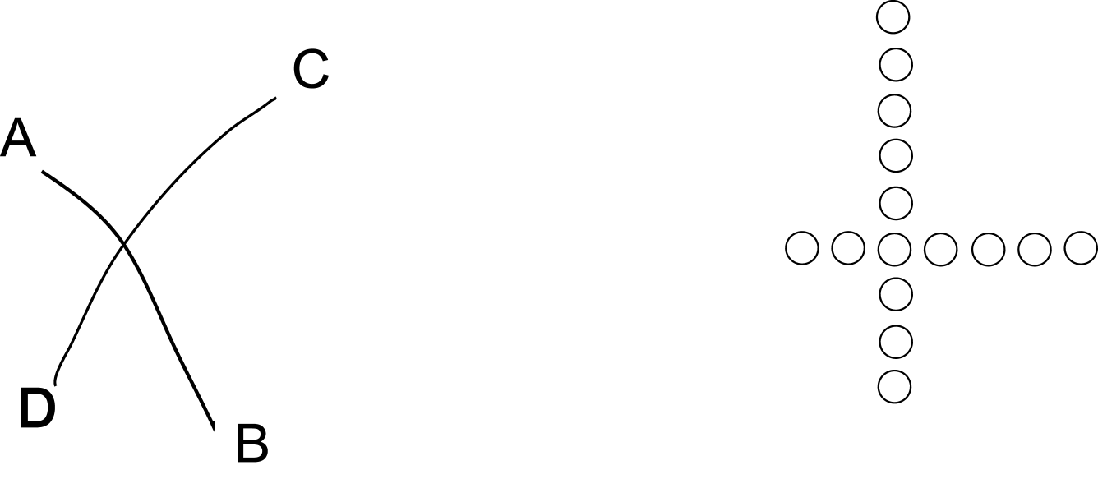
Continuity: flow, or alignment
We see curves AB and CD, not AC and DB, and not AD and BC
We see two rows of circles, not two L-shaped groups
Notes:
In fact there are two different ways to make L-shaped groups of the circles.

Slide 24

Closure: we mentally “fill in the blanks”
All are seen as circles
Reification is the constructive or generative aspect of perception,

Slide 25
Exercise (15 min.)
Divide in groups of 2-3
Make sure at least 1 PC pr. Group
Find examples of user interfaces using the different Gestalt principles
Start with your cell phone

Slide 26
Memory
Hierarchical Model
We get bombarded with sensor input constantly
Sensory
Short Term
Limited storage capacity 30 seconds to 2 minuts
Practice and effort needed
to make this transfer ➔
Long Term
High storage capacity, but not always reliable

Slide 27
“The Magic Number 7, Plus or Minus 2”
George Miller, 1956
  Max Short Term Memory Capability is 7± 2
Value of “ chunking”
  2125685382 vs. 212DanHome (American style Phone Numbers)
  10 chunks vs. 3 (assuming 212 is familiar)
Exercise for all: Can you remember:
  vsdfnjejn7dknsdnd33s8000com
Notes:
Miller did speak in terms of chunks. Some people dismiss his paper as irrelevant because it only has to do with remembering phone numbers, but that’s not an accurate reading. It is also true, however, that we try not to force users to remember lists. If they need the list, keep it visible. The paper is a good read; Google will find it for you.

Slide 28
How many chunks in . . .
www.bestbookbuys.com
20?
Not really:
  www.
  best
  book
  buys
  .com
  = 5
Is this the same for a user who has never used a browser (or heard about a DNS, URL, URI before?)
Is there any context related to this?

Slide 29
Exercise (2 min.)
Can you find examples of the “7± 2 rule” and “Chunking” that will supplement this discussion?

Slide 30
Recognition vs. recall
Why is a multiple choice test easier than an essay test?
  Multiple choice: you can recognize the answer
  Essay: you must recall the answer
A computer (or an appliance) with a GUI allows us to recognize commands on a menu, instead of remembering them as in DOS and UNIX

Slide 31
Interruptions
Focusing attention and handling interruptions are related to memory
In usability design you need to give cues or memory aids for resuming tasks:
  Back button
  Already chosen menus change color (like followed links)
  When filling in forms, blank boxes show where to pick up the job
  How does your cell phone’s SMS application handle Interruptions?
  Can you think of any examples where this is a problem?

Slide 32
Interruptions, continued
How fast must a system respond before the user’s attention is diverted? (Robert Miller, 1968)
Response time User reaction
< 0.1 second Seems instantaneous
< 1 sec Notices delay, but does not lose thought
> 10 sec Switches to another task
Limits change according to context and user types
How do your cell phone support interruptions?

Slide 33
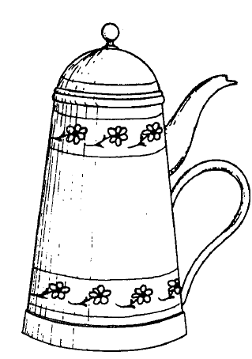
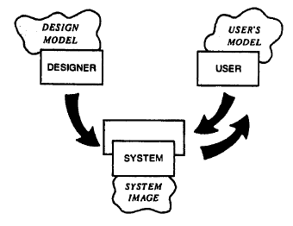
Mental / Conceptual Models
How do people use knowledge to understand or make predictions about new situations?
People build mental models – we are explanatory creatures
  Norman: Conceptual Model
For example, a car: put gas in, turn key, and it runs. (Not exactly a car mechanic’s model!)
Misconceptions of Everyday Live – Aristotle’s Naïve Physics
Can’t ignore user’s mental model
And how may we learn what the users’ mental models are?
Carelmans Coffepot for Masochists

Slide 34
Excercise (2 min)
In groups of two
Find examples of devices or appliances where your mental model was way off the system model

Slide 35
Affordance
Affordance: “The functions or services that an interface provides”
  A door affords entry to a room
  A radio button affords a 1-of-many choice
  On a door, a handle affords pulling; a crash bar affords pushing
  Virtual Affordances: A Windows button looks like a real world button

Slide 36
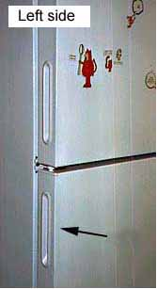
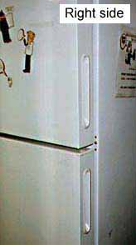
Bad Perceived Affordance
How to open the refrigerator?
Actually opens on the
right side.
What is wrong:
Perceived Affordance (door handle) is same left & right
Many refrigerators opens left side (convention)
From www.baddesigns.com

Slide 37


Perceived Affordance / Mappings
We want affordance to be visible and obvious to the user
  The Up and Down lights on an elevator door should have arrows, or they should be placed vertically so that the top one means Up
  On a car, turning the steering wheel to the left makes the car go left – sailing boats are often reversed!
  Always provide good mappings in the user interface
  The Gulf of Execution and The Gulf of Evaluation

Slide 38
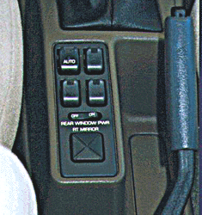
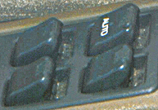
Bad Mappings / Affordance
Where are the window controls? Between the seats?
Where should it be?
Now – how to lower a window
Simply push the button
How to raise windows again?
Lift up a button to raise a window!
From www.baddesigns.com

Slide 39
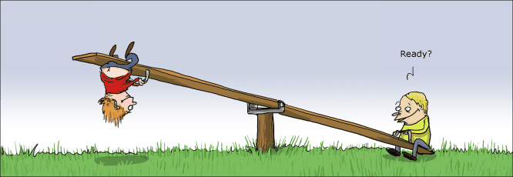
Bad Affordance
Beware of trusting strange affordances

Slide 40
Excercise (2 min)
Find examples of affordances
Real or percieved

Slide 41
Associate Thinking and the Importance of Meaning
Associative thinking
  Using Icons to understand abstract functions
The Importance of meaning
  DOS, SOAP, CORBA harder than “File System” or “Trashcan”– use Metaphors
Examples?

Slide 42
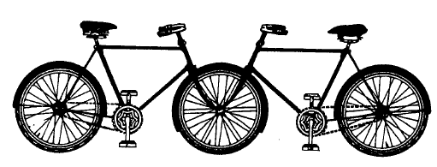
Normans Fundamental Principles
Provide a Good Conceptual Model
Make Things Visible
  ( Norman 1990, p.13)

Slide 43
Group Work (15 min.)
Form a Group at each table – 3 to 4 students :
Discuss
  Examples of Affordances
  Examples of Mental Models
  How to support Short and Long Term Memory
  Remember the Alarm Clock and using another persons Cell Phone?

Slide 44
After the Break (if time)
Please find an example at www.baddesigns.com
  Conceptual Model / System Image
  Bad Mappings / Affordances
  Other Problems you might find …
  Redesign suggestions

Slide 45
Methods
Cognition Psychology makes assumptions on user behavior – and believes in it
We can isolate users in the LAB and make testing that is hard science (quantitative empirical data)
  Example methods: Think aloud, observational lab study
We can “predict” usability – task performance time (calculating number of necessary key strokes or mouse clicks based on Motor Behavior Models) –
  Example methods: KLA, GOMS
We can try to “predict” usability problems, by simulating the user – done by designer & analyst
  Example methods: Cognitive Walkthrough
Or we can study actual usage by users in the real world
  Example methods: Field studies

Slide 46
Evaluation without users
Quantitative Methods
  GOMS (low level)
  Keystroke Level Analysis (KLA)
  Back-of-the-envelope action analysis
Qualitative Methods
  Expert evaluation (high level)
  Cognitive walkthrough (high level)
  Heuristic evaluation (high level)
Methods are just tools for structuring our work

Slide 47
With or without users
Users are the gold standard
  They cannot be simulated perfectly
Users are expensive and inconsistent
  Usability studies require several users
  Some users provide great information, others little
  Nearly always qualitative studies
    Too expensive to make quantitative
Best choice do both
  Start out without – later with

Slide 48
GOMS/Keystroke Level Model
Defined by Card, Moran and Newell
Formal action analysis
  Accurately predict task completion time for skilled users
Break task into tiny steps
  Keystroke, mouse movement, refocus gaze
  Retrieve item from long-term memory
Look up average step times
  Tables from large experiments

Slide 49
GOMS Analysis
Goals
  Including dividing into sub goals – what is to be achieved
  Change a word in a text document
Operators
  Elementary perceptual/motor/cognitive acts
  Click mouse, look at a menu bar, remember a name
Methods
  A series of operators to achieve goal
  Move mouse to point at word, then double-click
Selection Rules
  to decide which course of action to take to accomplish task
  Use “Cut menu”, or pressing the Delete key, etc.

Slide 50
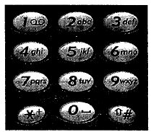
GOMS/Keystroke Level Model
Primary utility: repetitive tasks
  e.g., telephone operators, SMS users (T9)
  Benefit: can be very accurate (within 20%)
  May identify bottlenecks
Difficulties
  Challenging to decompose accurately
  Long/laborious process
  Not useful with non-expert users

Slide 51
Cognitive Walkthrough
Lewis & Wharton
Goals
  to critique the designers assumptions about the design
    Imagine user’s experience
    Evaluate choice-points in the interface
    Detect e.g. confusing labels or options
    Detect likely user navigation errors
Start with a complete scenario
  Never try to “wing it” on a walkthrough

Slide 52
Tell a Believable Story
How does the user accomplish the task
Action-by-action
  Tasks should be important
  Tasks should be realistic
Based on user knowledge and system interface

Slide 53
Best Approach
Work as a group
  Don’t partition the task
Be highly skeptical
  Remember, the goal is to improve the UI
Every gap is an interface problem

Slide 54
Who Should Do the Walkthrough
Designers, as an early check
Team of designers & users
  Remember: goal is to find problems
  Avoid making it a show
Skilled UI people may be valuable team members

Slide 55
How Far Along
Basic requirements
  Description or prototype of interface
  Know who users are (and their experience)
  Task description
  List of actions to complete the task (scenario)
Viable once the scenario and interface sketch are completed
But can be done anytime …

Slide 56
Outline of CW
Preparation
  Define assumed user background
  Choose sample task
  Specify correct action sequences for task
  Determine interface states along the sequences
Analysis
  For each correct action
    Construct a success story that explains why a user would choose that action OR
    Use a failure story to indicate why a user would not choose that action
  Record problems, reasons & assumptions
  Consider and record design alternatives
Follow-up
  Modify the interface design to eliminate problems -> redesign!

Slide 57
How to Proceed
For each action in the sequence
  Tell the story of why the user will do it
  Ask critical questions
    Will the user be trying to achieve the right effect?
    Will the user notice that the correct action is available?
    Will the user select a different control instead?
    Will the user associate the correct action with the desired effect?
    Will the user understand the feedback – and that progress has been made?

Slide 58
Walkthroughs are not Perfect
They won’t find every problem
A useful tool in conjunction with others
Conclusions from Lewis & Wharton (taken from overview of different related studies)
  CW finds about 40% (or more) of the problems later revealed by user testing
  CW takes substantially less effort than user testing
  Considering problems found per unit effort, CW may not be much more cost effective than user testing
  Heuristic Evaluation finds more problems than the CW and takes less effort
  CW can be tedious and too much concerned with low-level details
  CW does not provide a high-level perspective on the interface
  CW’s performed by groups of analysts work better than those done by individuals
After the exercises – you may form your own opinion

